Slide 1

Housing MarketAnalysis FOR CITIES IN BRITISH COLUMBIA BY: DEEPIKA, GOSAYE, DHAWANPREET, & HUMA

Slide 2

INTRODUCTION:
Let’s look into some 2018-2019 Analytics of the British Columbia (BC) Housing Market based on few Buyer Characteristics: - Total Sale Price - Family Size - Age Group - Immigration Status
Data used from Statistics Canada - 2018 & 2019
After taking a deep dive into the analysis we will be able to better explain the housing market trends for 2018-2019 in BC
This Photo by Unknown Author is licensed under CC BY

Slide 3
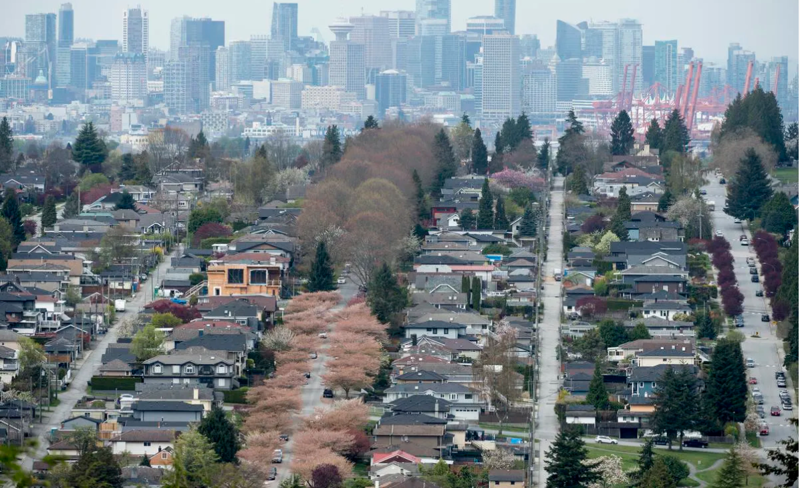
ANALYSIS OF TOTAL INCOME AND HOUSE PRICES

Slide 4

Overall Objective
Gather Housing Market data for BC for years 2018 and 2019
Analyze data to determine trends, correlations and useful stats
Our Objective
Determine any trends or relation between:
Average Sale Price and Buyer’s Gender:
(analyzed data represented by pie chart)
Average Sale Price and Buyer’s Income and total number of Buyers per property:
(analyzed data represented by scatter plots)

Slide 5
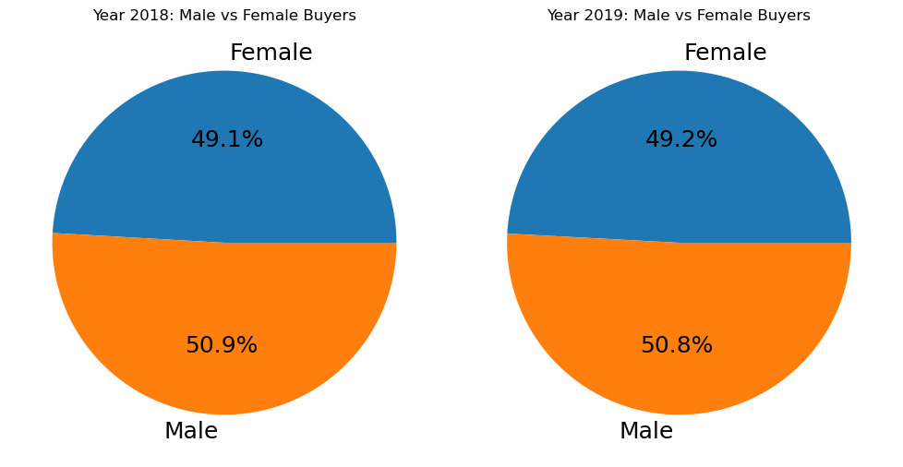
Objective: To determine which gender bought more property
Question: Did a specific Gender accumulate a higher percentage of sales for 2018 and 2019?
Average Sale Price Vs Gender (Male, Female)
Analysis: As shown in the charts above the male gender has the higher percentage of sales for both 2018 and 2019.
(Main contributing factor to the result would likely be the buyer’s income)

Slide 6
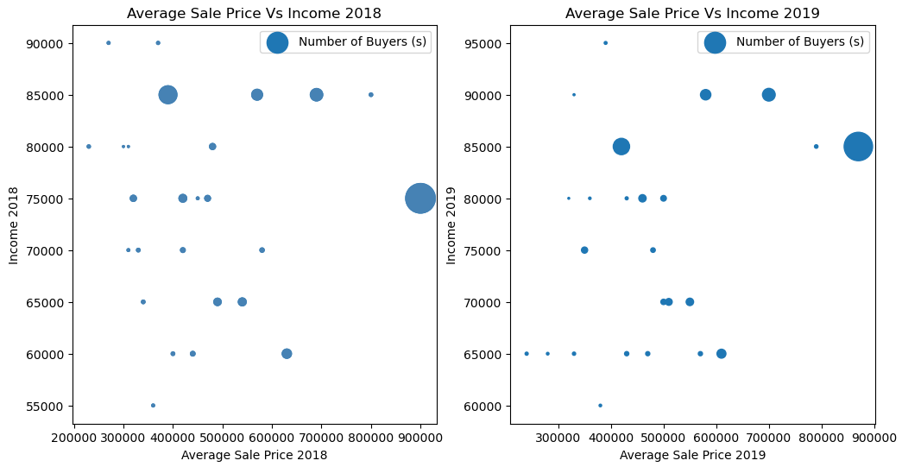
Total Buyer Income Vs Number of Buyers
Objective: To determine if there is any relation between income, sale price and number of buyers per property.
Question: Is the Number of Buyers defined by Buyers Total Income and Sales Price?
Analysis: There seems to be no relation or link between income and the price of the home for both 2018 and 2019.

Slide 7
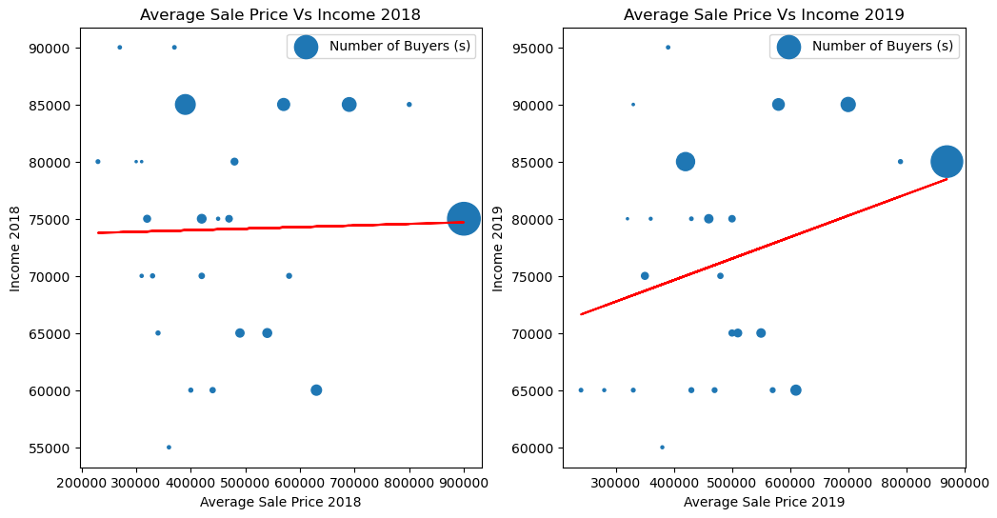
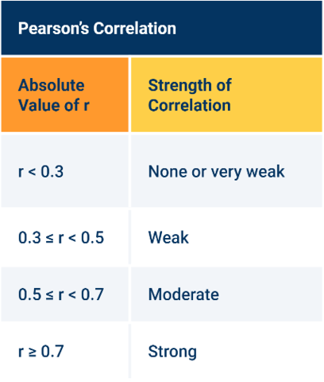
Regression Test of Income vs Price
R-value: 0.023020987575531428
R-value: 0.285838100252809
After doing the regression test you can statistically see that there is a very weak correlation for both 2018 and 2019. This mathematically proves that there is no real connection between, Price and Total Income for Number of Buyers Size.
Ps. the reason for the linear line in Figure 2 is due to an outlier. The outlier has no real value towards the overall regression test.

Slide 8
FAMILY SIZE & BC HOUSING

Slide 9

Family Size and Housing
We will investigate these 3 following Buyer Charecteristics:
1) Couple Family with Children
2) Couple Family without Children
3) Lone (Single) Parent Family
Let’s start with what is the total percentage of Average number of buyers from the above categories

Slide 10

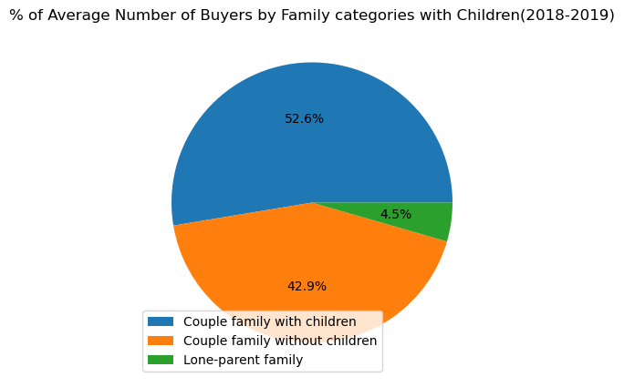



Family Size and Average Number of Buyers
From the pie chart we can see that Number of house buyer’s is higher for people with children and least for Lone-Parent Famiy

Slide 11
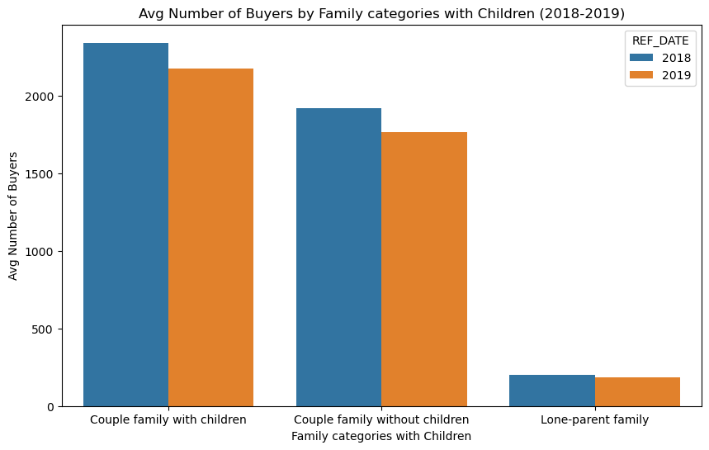
Family Size and Average Number of Buyers
From comparing the number of buyers for each buyer charecteristic, it’s interesting to see the number slighlty dipped down for 2019. But the trend for the buyer charecteristics is the same.

Slide 12
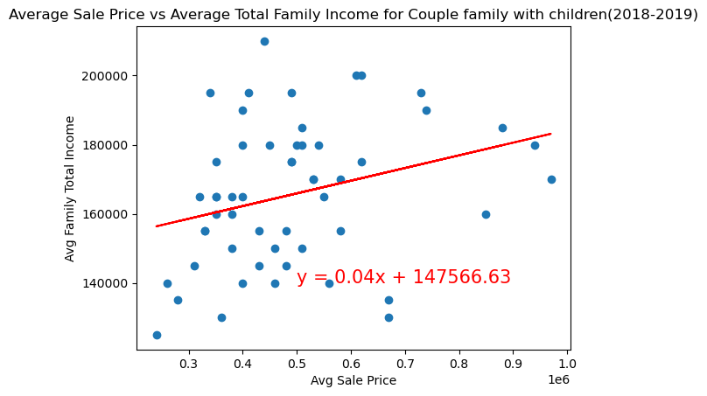
Does average family income and sale price have any correlation?
From the regression test the r value obtained is 0.29353255724037314.
r-value is less than 0.3 so the correlation between Average Income and Average sale price for number of buyers for couple with children is very weak.

Slide 13
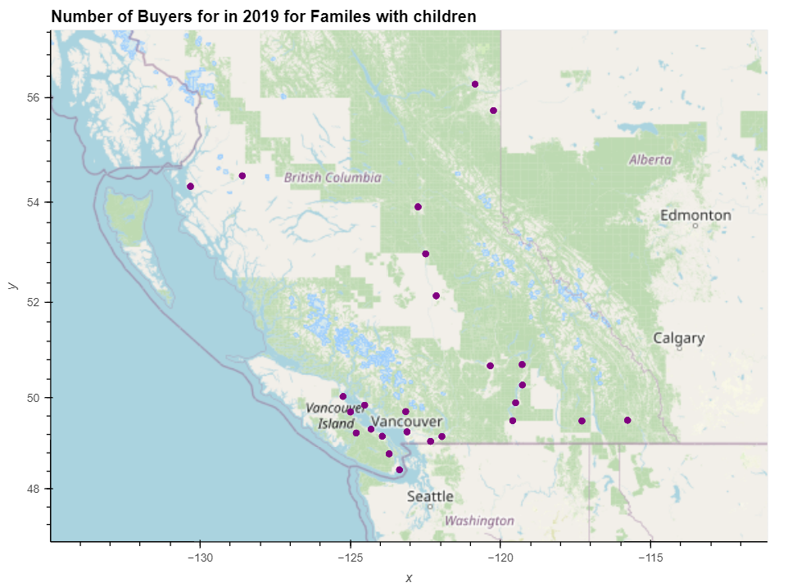
From the map view we can concur that number of buyers with children are mostly located more towards Vancouver area or the south of British Colombia than to the north.

Slide 14
AGE GROUP & BC HOUSING PRICES

Slide 15

Age Group Analysis 2018 & 2019:
If the Age has any affect on the Average Sale Price ?
Does Age reflect how many people can likely afford a house by a particular age than others ?
In the end we check if there is any relationship between the Average Sale Price and Average Buyers Age?

Slide 16
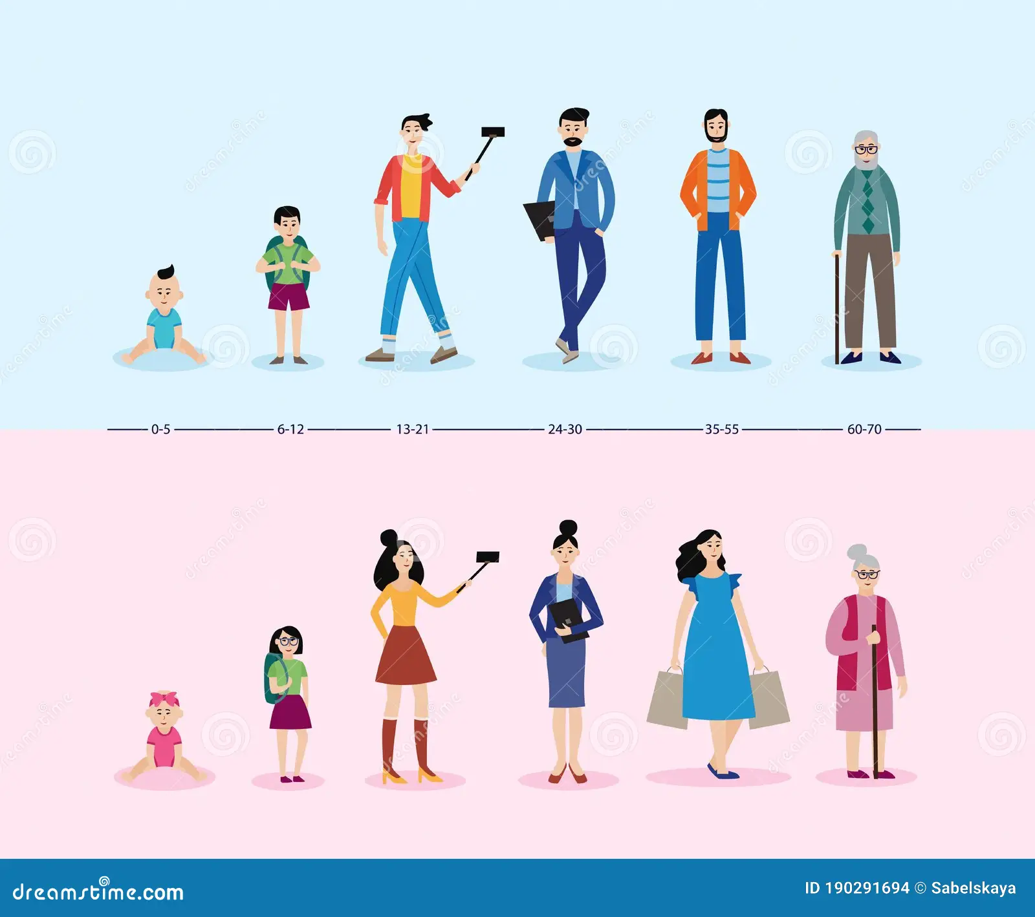
Different Age Groups
1. Under the Age of 35
2. 35- 54 years old
3. 55 years and older

Slide 17
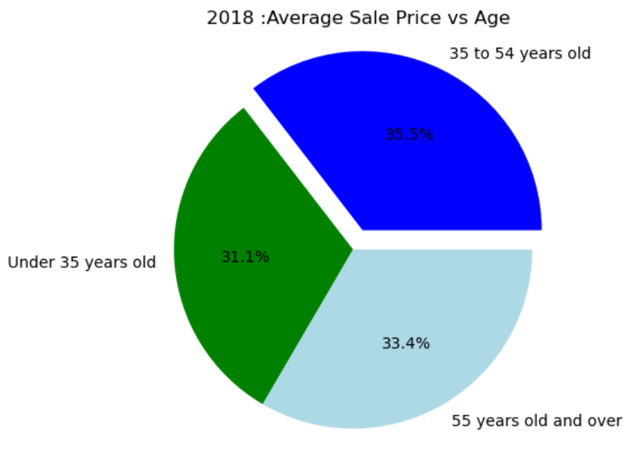
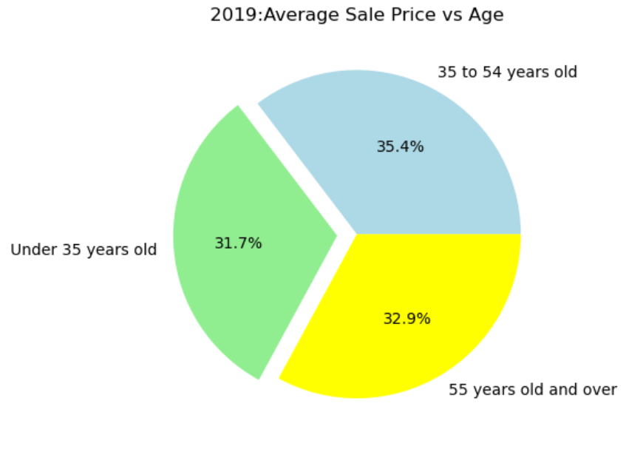
Analysis of Age groups vs Average Sale Price

Slide 18
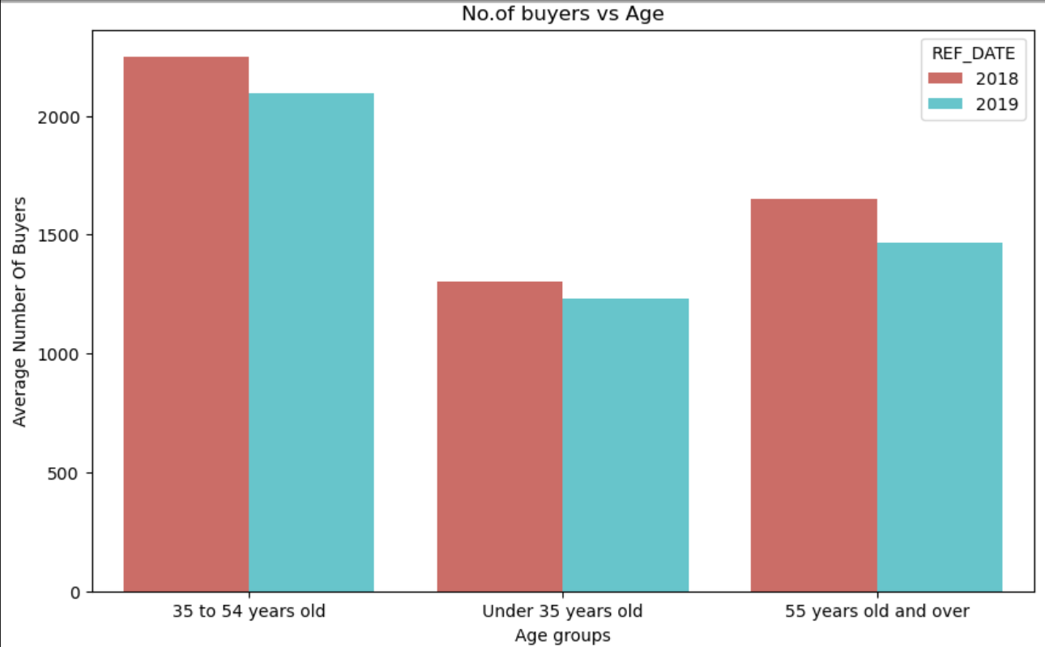
Age vs Number of Buyers
Bar graph clearly illustrates that the number of buyers in the age group of 35 to 54 years old are the highest in number

Slide 19
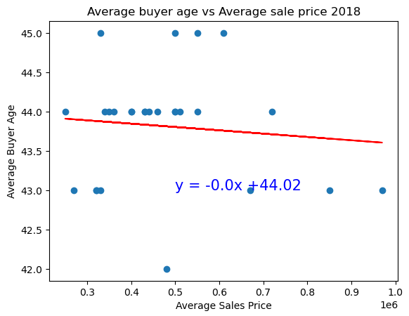
Correlation between Average Sale Price vs Average Buyer Age
This Plot shows the correlation between Average Sale price and Average Buyer age
The regress value is -0.0983 which is less than 0.3, means there is a weak correlation between these two variables

Slide 20
IMMIGRATION STATUS & BC HOUSING PRICES

Slide 21
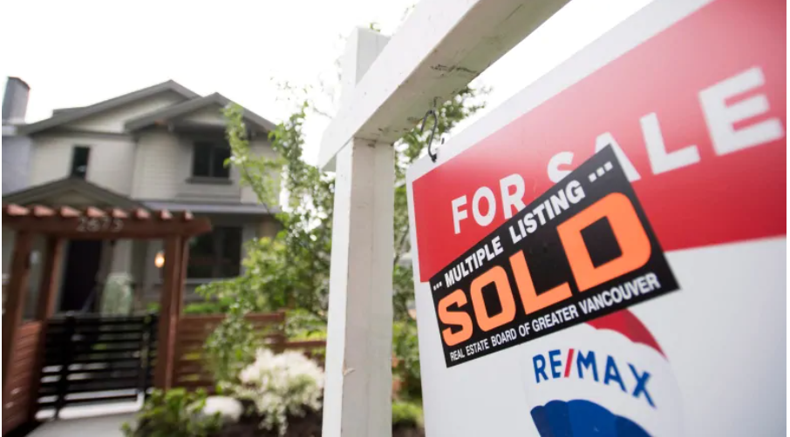
OBJECTIVE: Does Immigration Status Affect the House Price Purchased?
We will look into the status of: 1) Immigrant: “Immigrant" refers to a person who is, or who has ever been, a landed immigrant or permanent resident. Such a person has been granted the right to live in Canada permanently by immigration authorities. Immigrants who have obtained Canadian citizenship by naturalization are included in this group.” – Statistics Canada
2) Non- Immigrant: Canadian Born individuals, not naturalized

Slide 22

OBJECTIVE: Does Immigration Status Affect the House Price Purchased?
We will observe Immigration and Non- Immigration Status against BC House Price and Units Sold for 2018-2019:
1) 2018-2019 Immigration Status vs. Average Number of Property Buyers
2) Immigrant vs. Non- Immigrant Status: 2018-2019 Average Total Income of Property Buyer vs. Average Sales Price (CDN $)

Slide 23
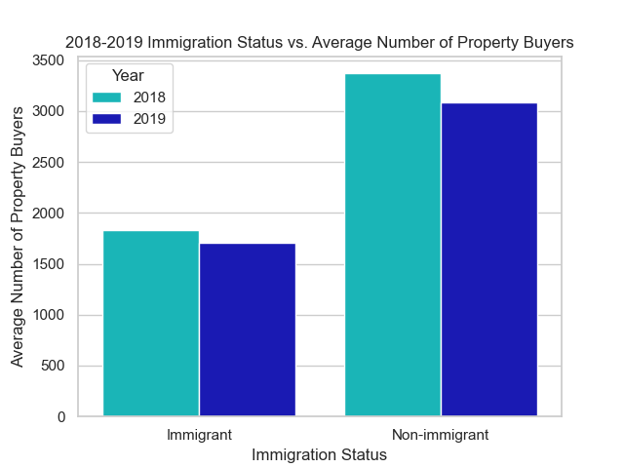
Immigration Status and Average Number of Property Buyers 2018-2019
Combined 2018-2019, Non-Immigrants bought houses almost more than half against Immigrants in BC
Also, for both groups, more house were purchased in 2018 than in 2019

Slide 24
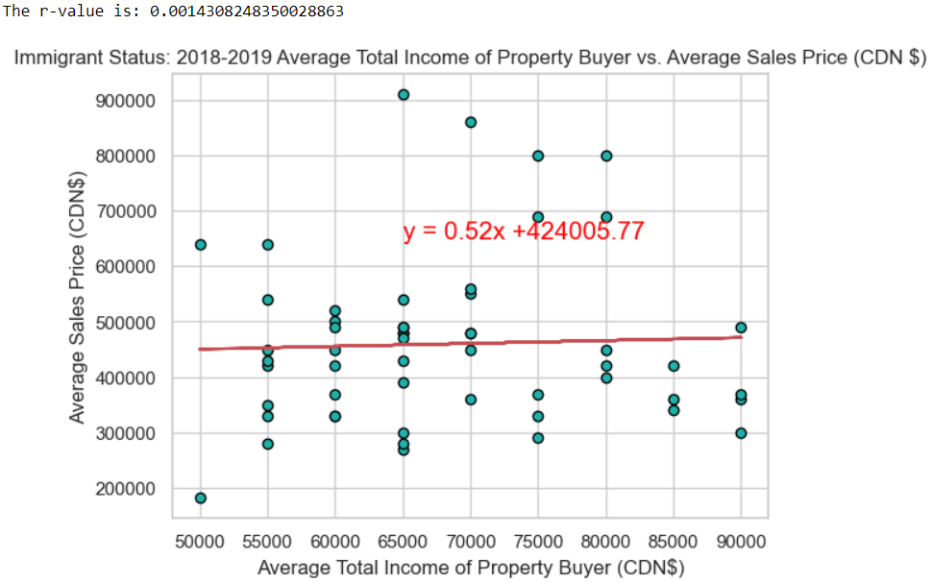
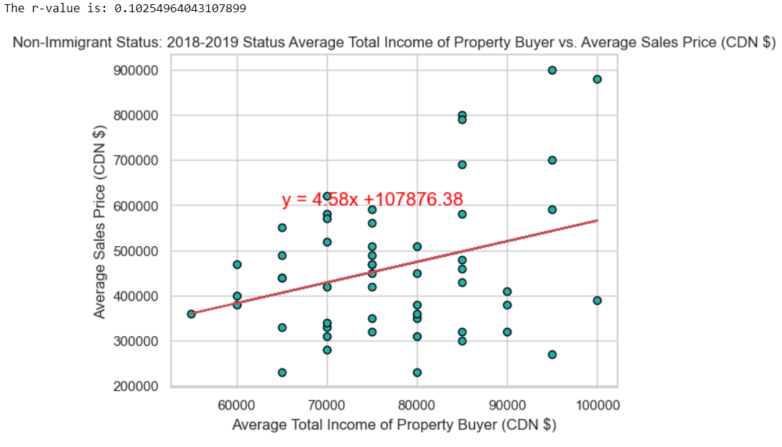
2018- 2019 Immigrant vs. Non- Immigrant Status
Immigrant Status: Average Sales vs. Average Total Income does not affect whether an individual is an Immigrant, due to the low correlation of 0.00143. Indicating other factors.
Non Immigrant Status: With the correlation of 0.103, indicating there is a low relation between the Average Sales Price and Average Total Income

Slide 25
CONCLUSION
Question: What were the trends in BC Housing Market between 2018-2019, with the Buyer Characteristics observed:
Number of Houses Sold decreased from 2018-2019
The age group of 35 to 54 years old are the highest in number of home purchasers
Groups with children bought the most houses
The number of houses are the same between men and women in 2018-2019
FURTHER CONCLUSION: If you are 44, have a family and are non-immigrant you were more likely to be able to buy a house in BC between 2018-2019.
WAY FORWARD: What factors would actually effect the BC Housing Market?

Slide 26
Housing MarketAnalysis FOR CITIES IN BRITISH COLUMBIA BY: DEEPIKA, GOSAYE, DWANPREET, & HUMA

Slide 27
REFRENCE
Reference Link: Data: https://www150.statcan.gc.ca/t1/tbl1/en/cv.action?pid=4610006201
Pictures:
https://www.thestar.com/vancouver/2019/05/28/government-policies-weigh-on-declining-bc-housing-market-report-says.html
https://www.fridman.ca/2018/04/24/living-canada-without-status/

